Slide 1
UNIT I
Introduction to Apache Spark
Course: INT315 – Cluster Computing

Slide 2
What is Cluster Computing?
Cluster computing uses multiple computers (nodes)
Nodes work together as one system
Tasks are divided and processed in parallel
Why needed?
Single machines have limited CPU & RAM Big data needs scalable computing

Slide 3
Why Apache Spark?
Apache Spark is a fast cluster computing framework used for:
Big data processing Analytics
Machine learning Streaming data

Slide 4
Hadoop MapReduce – Background
Hadoop MapReduce was the first popular big data framework.
How it works:
Read data from disk
Process data
Write results back to disk

Slide 5

Limitations of Hadoop MapReduce
Disk-based processing Slow execution
Not suitable for real-time analytics Complex programming model
Result:
Inefficient for iterative & interactive tasks

Slide 6
Batch Processing vs Real-Time Analytics
Batch Processing
Large data sets Processed periodically
Example: Monthly sales report
Real-Time Analytics Continuous data stream Low latency
Example: Stock prices, sensor data

Slide 7

Spark Advantage
Apache Spark supports:
Batch processing
Real-time stream processing
One framework for multiple workloads

Slide 8
In-Memory Processing (Key Concept)
Traditional systems
Read → Process → Write to disk
Spark
Read → Process → Store in RAM
Benefit
Very fast execution
Efficient iterative computation

Slide 9
Features of Apache Spark
In-memory computation Fault tolerance
Lazy evaluation
Supports Scala, Python, Java Rich ecosystem

Slide 10
Spark Ecosystem
Spark Core: provides the basic functionalities such as task dispatching, scheduling, and fault recovery, and interacts with various storage systems
Spark SQL: working with structured data. It allows users to query data using SQL or the DataFrame API, integrating SQL queries.
Spark Streaming: process live data streams, micro-batching that treats live streams as a sequence of small batches of data
MLlib (Machine Learning): machine learning library.
GraphX (Graph Processing): manipulating graphs and performing graph-parallel computations

Slide 11
Spark vs Hadoop Ecosystem
Feature | Hadoop | Spark
Processing | Disk-based | In-memory
Speed | Slow | Fast
Streaming | External | Built-in
ML Support | Limited | MLlib

Slide 12
Spark Installation Mode
Standalone Mode
Single machine
Simulates cluster behavior Best for learning & practice

Slide 13
Prerequisites for Spark Installation
Java JDK 8 or 11
Python (for PySpark)
Operating System: Windows / Linux
-Spark 4.x: This version requires Java 17 or Java 21.
-Spark 3.5.x: This version supports Java 8 and 11.

Slide 14
Step 1: Install Java
Check Java version:
java -version
If not installed:
Install JDK 8 or 11 Set JAVA_HOME
You can download java form this link [check the compatibility]
https://www.oracle.com/java/technologies/javase/jdk17-archive-downloads.html

Slide 15
Step 2: Install Python
Check Python version:
python --version
Required for PySpark in later units

Slide 16
Step 3: Download Apache Spark
Visit spark.apache.org
Download latest stable version (https://spark.apache.org/downloads.html)
Extract to system directory
Example:
C:\spark-4.1.1-bin-hadoop3

Slide 17
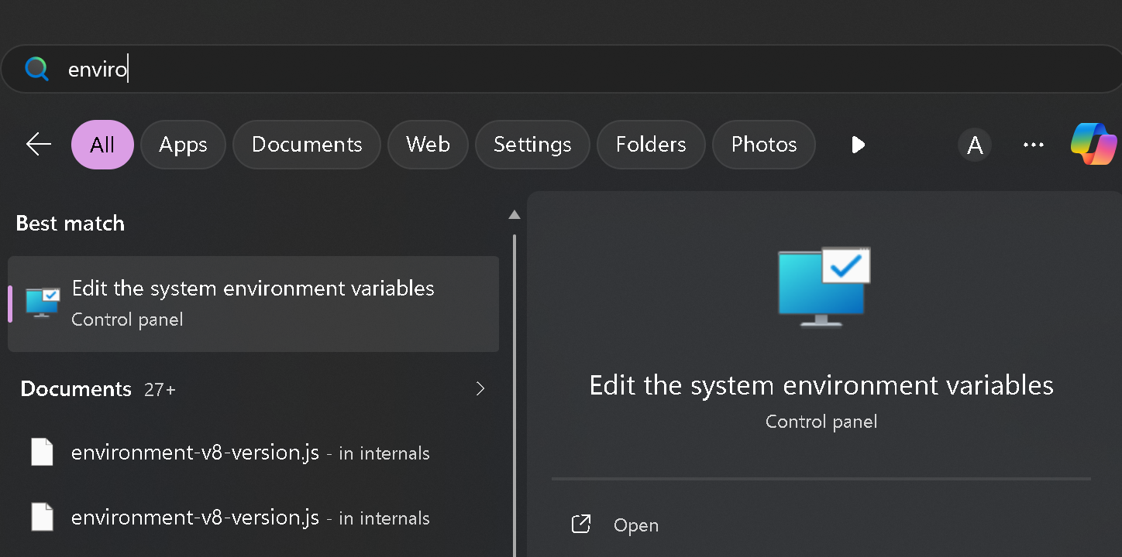
Step 4: Set Environment Variables
Set System Variables as follows:
Name: "SPARK_HOME"
Value: "C:\spark-4.1.1-bin-hadoop3"
Add SPARK_HOME/bin to PATH "%SPARK_HOME%\bin"
Verify installation:
C:\spark-4.1.1-bin-hadoop3\bin>spark-shell
For Python
C:\spark-4.1.1-bin-hadoop3\bin>pyspark

Slide 18



INSTALLATION software/ tools SUMMARY TABLEs
Software | Install? | Used in Unit
Java JDK | Yes | All
Apache Spark | Yes | I–VI
Scala | Yes | II, III
Python | Yes | VI
Apache Kafka | Yes | V
Hadoop | No | —
VS Code | Recommended | All

Slide 19
Spark Shell
When Spark starts successfully, you will see:
/ / / /
_\ \/ _ \/ _ `/ / '_/
/ / . /\_,_/_/ /_/\_\
/_/
version
4.1.1
Spark context available as sc
scala>
You are ready to use Spark!

Slide 20
First Spark Program (Scala)
val data = List(1,2,3,4,5)
val rdd = sc.parallelize(data) rdd.map(x => x * 2).collect()
Output
Array(2, 4, 6, 8, 10)
This is a distributed computation!

Slide 21


Step-by-step explanation
val data = List(1,2,3,4,5)
Creates a Scala list in memory with 5 integers.
val rdd = sc.parallelize(data)
sc is the SparkContext.
parallelize converts the local Scala collection into a Resilient Distributed Dataset (RDD).
Spark splits the list into partitions (chunks of data). Each partition can be processed in parallel by different executors/cores.

Slide 22
rdd.map(x => x * 2).collect()
Applies a transformation: multiply each element by 2.
This operation is lazy — Spark doesn’t execute it immediately, it just builds a computation plan.
collect()
An action that triggers execution.
Spark sends the map task to worker threads/cores, processes each partition in parallel, and then gathers the results back to the driver program.
Output: Array(2, 4, 6, 8, 10)

Slide 23


How parallelism works here
Spark distributes the list across partitions.
Each partition is processed independently by a task.
Tasks run in parallel across available CPU cores in the Spark cluster (or on your local machine if you’re running locally).
Check Spark configuration in Scala
scala> sc.master
val res1: String = local[*]

Slide 24
How many processors are used?
By default, sc.parallelize(data) creates as many partitions as the number of cores available, unless you specify otherwise.
On a local machine:
If you started Spark with local[*], it uses all available cores. If you started Spark with local[2], it uses 2 cores.
If you didn’t specify, the default is usually local[1] (single core).
So the number of processors depends on your SparkContext configuration, not the code itself.
Default comes from no explicit setting → Spark uses local[*]

Slide 25
Standalone install Scala
Spark bundles its own Scala runtime inside spark-shell, so you can run Scala code there.
But the standalone Scala compiler/runner (scala, scalac) is not included in Spark’s bin folder. That’s why scala isn’t recognized on Windows.
To fix this, you need to install Scala separately and add it to your PATH
Download from the official site: https://www.scala-lang.org/download.
Add Scala to PATH
Verify installation
scala -version scalac -version

Slide 26
Spark doesn’t provide the scala command, but you can run Scala code inside spark-shell.
:load Hello.scala Hello.main(Array())
C:\spark-4.1.1-bin-hadoop3\bin>spark-shell scala> :load Hello.scala
val args: Array[String] = Array() Loading Hello.scala...
object object
Utils Hello
scala> Hello.main(Array()) Hello Scala
7
scala> :quit
C:\spark-4.1.1-bin-hadoop3\bin>

Slide 27
Feature | Apache Hadoop (MapReduce) | Apache Spark
Processing Style | Primarily Batch processing | Batch, Real-time (Streaming), and Interactive
Data Storage | Native storage (HDFS) | No native storage; reads from HDFS, S3, Azure, etc.
Performance | Slower (Disk-based I/O between tasks) | Up to 100x faster (In-memory processing)
Cost | Lower (Runs on standard/commodity hardware) | Higher (Requires significant RAM)
Ease of Use | Complex; requires low-level Java/Python | User-friendly; high-level APIs in Python, Scala, R, Java
Security | Highly mature (Kerberos, LDAP, ACLs) | Basic (Shared secrets); often relies on Hadoop for security
Fault Tolerance | Data replication across multiple nodes | RDD lineage (recomputes lost data)
Machine Learning | Requires external libraries (e.g., Apache Mahout) | Built-in MLlib library
Resource Manager | Native YARN | Standalone, YARN, Kubernetes, or Mesos

Slide 28
Summary – Unit I
Introduction to cluster computing Limitations of Hadoop MapReduce Spark advantages
Batch vs real-time analytics In-memory computation Spark installation
First Spark program

Slide 29
Next Unit
Unit II: Programming in Scala
Scala basics
Data types & collections Functions
Spark-friendly Scala coding

Slide 30
Thank You

Slide 31
MCQs – Unit I: Introduction to Apache Spark

Slide 32
What is the main purpose of cluster computing?
To store data permanently
To process data using a single powerful machine
To perform parallel processing using multiple machines
To reduce data size

Slide 33
Correct Answer: C

Slide 34
Which of the following is a limitation of Hadoop MapReduce?
Fault tolerance
Disk-based processing
Scalability
Distributed storage

Slide 35
Correct Answer: B

Slide 36
Why is Apache Spark faster than Hadoop MapReduce?
It uses more machines
It uses in-memory processing
It avoids parallelism
It stores data permanently

Slide 37
Correct Answer: B

Slide 38
Which type of processing is suitable for real-time analytics?
Batch processing
Offline processing
Real-time processing
Sequential processing

Slide 39
Correct Answer: C

Slide 40
Which of the following workloads can Apache Spark handle?
Only batch processing
Only real-time processing
Both batch and real-time processing
Only streaming processing

Slide 41
Correct Answer: C

Slide 42
In Spark, keeping data in memory mainly helps to:
Increase storage capacity
Reduce CPU usage
Speed up data processing
Improve network speed

Slide 43
Correct Answer: C

Slide 44
Which Spark component provides SQL-like querying?
Spark Core
Spark Streaming
Spark SQL
GraphX

Slide 45
Correct Answer: C

Slide 46
Which of the following is NOT a feature of Apache Spark?
Lazy evaluation
Fault tolerance
In-memory computation
Disk-only execution

Slide 47
Correct Answer: D

Slide 48
Which mode of Spark installation is best for beginners?
Cluster mode
YARN mode
Standalone (local) mode
Cloud mode

Slide 49
Correct Answer: C

Slide 50

When Spark starts successfully, which object is automatically created?
sparkSession
rddContext
SparkContext (sc)
HadoopContext

Slide 51
Correct Answer: C

Slide 52
Which statement correctly compares Spark and Hadoop?
Spark replaces Hadoop completely
Hadoop is faster than Spark
Spark complements Hadoop
Spark cannot work with Hadoop

Slide 53
Correct Answer: C

Slide 54
Which feature makes Spark suitable for iterative algorithms?
Disk-based execution
In-memory computation
Sequential processing
Static data storage

Slide 55
Correct Answer: B

